Slide 1



VALUING OFF-BALL RUNS IN IMPROVING DRIBBLING SUCCESS
Adam Endress
Computer Science
Oregon State University
JANUARY 2026
Notes:
Thank you and Good Afternoon

Slide 2
Contrasting Views of Dribbling
QUOTE #1
QUOTE #2
“Today, without players who dribble, nothing can be done. Attacking a team that is stuck in its own goal, without players who dribble, who do not get you superiority with moves into spaces, is impossible”
“If I play with one or two touches within a second or two to you, you know exactly what will happen. It’s communication. It’s talking. If a player runs and dribbles with the ball all the time, no one knows what will happen”
Notes:
I want to start sharing 2 quotes
The First one: “Today, without players who dribble, nothing can be done. Attacking a team that is stuck in its own goal, without players who dribble, who do not get you superiority with moves into spaces, is impossible.”
And the second
“If I play with one or two touches within a second or two to you, you know exactly what will happen. It's communication. It's talking. If a player runs and dribbles with the ball all the time, no one knows what will happen.”
Two quotes that show very different views on dribbling.
The first is from perhaps the greatest manager of all time, Pep Guardiola. The message is clear: It’s impossible to win without dribblers.

Slide 3
Contrasting Views of Dribbling
QUOTE #1
QUOTE #2
“Today, without players who dribble, nothing can be done. Attacking a team that is stuck in its own goal, without players who dribble, who do not get you superiority with moves into spaces, is impossible”
Pep Guardiola
“If I play with one or two touches within a second or two to you, you know exactly what will happen. It’s communication. It’s talking. If a player runs and dribbles with the ball all the time, no one knows what will happen”
Jon Dahl Tomasson
Notes:
The second is from Jon Dahl Tomasson, the previous manager of Sweden. He seems to view dribbling as this disruptive noise in the clear communication of the passing game, unable to be understood and acted upon by teammates.

Slide 4
Dribbling as a Team Action
Dribbling often considered solely an individual action
Yet, dribbling occurs within a dynamic game
What if there is more to dribbling success than individual skill?
Notes:
There’s this thought that dribbling is an individual action. The outcome is determined solely based on the skill of the attacker vs the skill of the defender. But dribbling exists within a dynamic ecosystem where space and opportunity change as players move. So is dribbling just noise as Tomasson thinks or are players and coaches just not listening for the voices within?
With this research, I sought to find the voices in the so-called disruptive noise of dribbling and explore connections between off-ball runs and dribbling success.

Slide 5

Off-Ball Runs and Dribbling Outcomes
Dribbling Success = Ball Retention or Ball Progression (Yes/No)
Research Questions
How do individual off-ball runs impact dribbling success?
How are dribbling outcomes impacted by the collective off-ball movement of teammates?
Notes:
To explore this, I wanted to look at the connections from two different perspectives.
How do individual off-ball runs impact dribble success, and
How are dribbles impacted by the collective off-ball movement of teammates?
Success was measured in two ways:
did the dribbler retain possession of ball, and
did the dribbler progress the ball following the dribble

Slide 6
Question #1 - Individual Off-Ball Runs
2a
Dribbles
1
3
Data
Analyses
Identify dribbling events:
N = 11,463
Coded as Yes/No for ball progression & retention
Generalized Mixed Models (GLMM) to test for off-ball run main effects on ball progression & retention
Pairwise comparisons using Tukey Kramer
Interactions not included due to low sample sizes
Data from 266 matches:
2024 NWSL Season
2024/2025 WSL Season
2b
Off-Ball Runs
Extracted using timestamps:
Type of run (10)
Possession Phase (6)
Channel (5)
Channel Difference (5)
Notes:
I looked at the dribble events from the provided Wyscout data, which included ball retention and progression metrics, which were coded as True/False.
I used timestamps to extract data from Skillcorner of all off-ball runs that coincided with dribbles. I excluded dribbles and runs in the direct, set piece, and disruption possession phases. Analysis focused on build up, create, finish, quick break, transition, and chaotic phases.
I then used Generalized Linear Mixed Models to test for the effects of possession phase, run type, vertical channel of the run, and channel difference of the dribble and run, or how many channels apart they were.

Slide 7
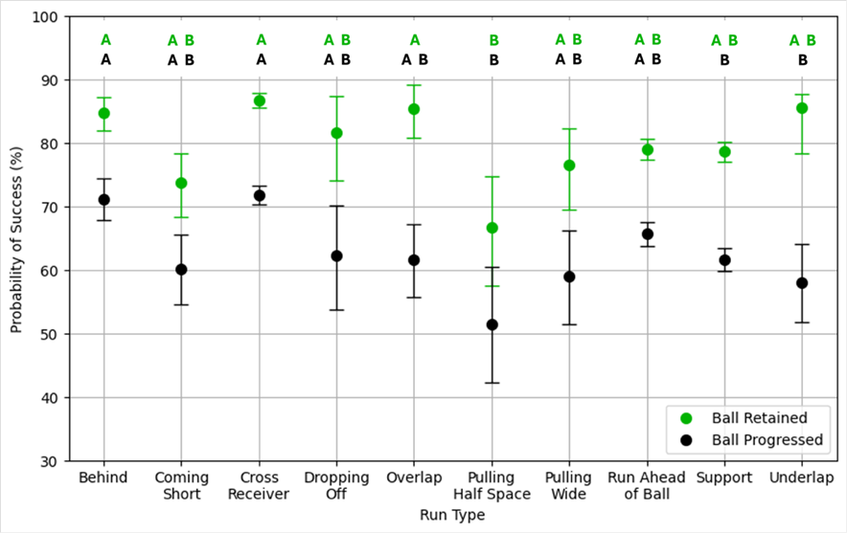
Question 1: Results
Dribble Success vs. Off Ball Run Type
Ball Retention
Possession Phase (p<0.0001), Run Type (p=0.0001), Run Channel (p=0.0248)
Ball Progression
Possession Phase (p<0.0001), Run Type (p<0.0001), Channel Difference (p=0.0007)
Examples
2.8 greater odds of ball retention with a ‘Cross Receiver’ run vs. ‘Pulling Half Space’ run
Runs in the same or adjacent channel to the dribble led to significantly lower odds of ball progression than runs two or three channels away
Notes:
Results from Question 1 showed that possession phase and run type had a significant effect on both ball retention and progression, run channel had a significant effect on ball retention, and channel difference had a significant effect on progression. Success rates varied among these factors.
The graph shows the effects of run type of dribble success. Ball retention results are in green, and ball progression is black. Tukey Kramer pairwise comparison results are at the top of the graph. The graph clearly shows the difference in success based on off ball movement.
I don’t have time to share all of the results from this analysis, but I wanted to provide a couple other results
For example, the odds of retaining the ball were 2.8 times greater with a cross receiver run than with a pulling half space run, and runs in the same or adjacent channel to the dribble led to significantly lower odds of progression than runs 2 to 3 channels away.

Slide 8
Question 1: Results
Dribble Success vs. Off Ball Run Type
Ball Retention
Possession Phase (p<0.0001), Run Type (p=0.0001), Run Channel (p=0.0248)
Ball Progression
Possession Phase (p<0.0001), Run Type (p<0.0001), Channel Difference (p=0.0007)
Examples
2.8 greater odds of ball retention with a ‘Cross Receiver’ run vs. ‘Pulling Half Space’ run
Runs in the same or adjacent channel to the dribble led to significantly lower odds of ball progression than runs two or three channels away
Notes:
Results from Question 1 showed that possession phase and run type had a significant effect on both ball retention and progression, run channel had a significant effect on ball retention, and channel difference had a significant effect on progression. Success rates varied among these factors.
The graph shows the effects of run type of dribble success. Ball retention results are in green, and ball progression is black. Tukey Kramer pairwise comparison results are at the top of the graph. The graph clearly shows the difference in success based on off ball movement.
I don’t have time to share all of the results from this analysis, but I wanted to provide a couple other results
For example, the odds of retaining the ball were 2.8 times greater with a cross receiver run than with a pulling half space run, and runs in the same or adjacent channel to the dribble led to significantly lower odds of progression than runs 2 to 3 channels away.

Slide 9
Question #2 - Team Movement
2a
No. of runs during a dribble
1
3
Data
Analyses
Relationship between the number of runs during dribbling event and progression or retention (Y/N)
Generalized Mixed Models (GLMM) to test for off-ball run main effects on ball progression & retention
Unbalanced data and low sample sizes prevented more complex models which accounted for phase of play, channel, and other potential covariates and interactions
Data from 266 matches:
2024 NWSL Season
2024/2025 WSL Season
2b
Collective team movement
Described team movement patterns usings K-means clustering based on 10,613 dribbling sequences
Notes:
The second question used the same data. I conducted two separate analyses to evaluate the effects of team movement on dribbling outcomes. First, I simply looked at the effect of the number of runs on dribbling success using a GLMM. For my second analysis, I first used k means clustering to group dribble events based on the number of each type of run that occurred at the time of the dribble. I then used GLMM to test for differences in ball retention and progression among the identified team movement patterns.

Slide 10
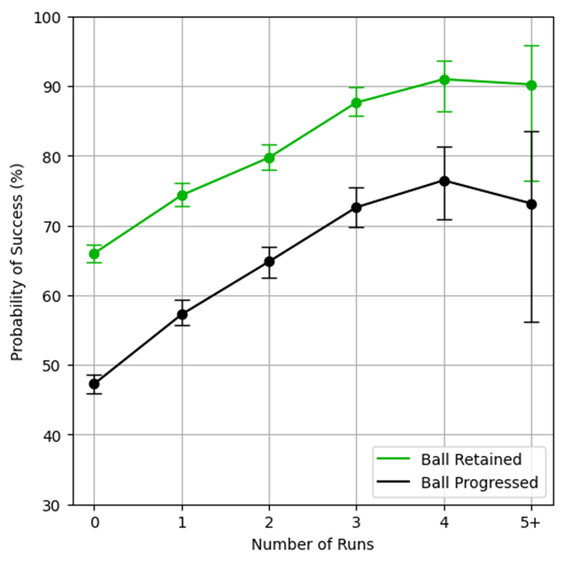
Question 2: Results
Dribble Success vs. Number of Off Ball Runs
Dribbling success increases with increasing number of concurrent off-ball runs (p <0.0001)
Positive effects accrue up to four off-ball runs
Limitation: Did not consider other factors such (e.g. possession phase, location on the field) or interactions
Notes:
The first part of question 2 was testing if the number of runs affects dribble success rate, and as you can see from the graph, it does. Each concurrent run, up to 4, significantly increased success rate for both retention and progression compared to any amount of fewer runs. This data clearly shows that runs matter. Just one run increased success in both metrics by around 10% and 4 concurrent runs increased success by around 25% compared to no runs.

Slide 11
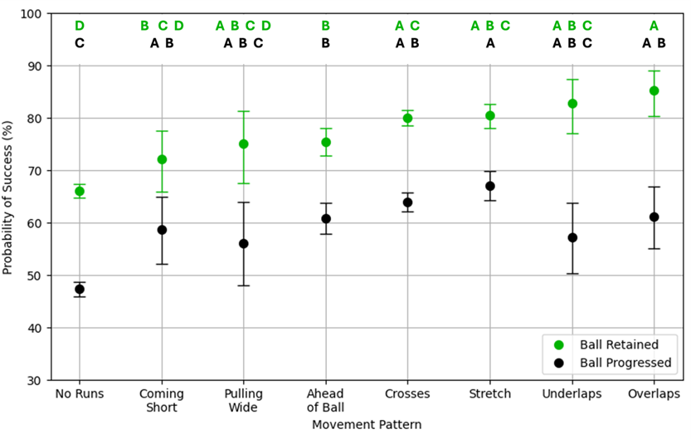
Question 2: Results
Dribble Success vs. Movement Pattern
K means clustering identified 13 patterns, 8 with sufficient sample size for analysis
Clear differences in success among movement patterns
Interpretations of pairwise comparisons difficult
Analysis did not account for other key factors which may clarify relationships
Notes:
In conclusion, dribbling outcomes are not solely determined by individual skill, but also by off-ball runs and team movement. All players can be active participants during a teammate’s dribble.
Team movement patterns can be described, characterized, and analyzed. 8 different patterns with sufficient sample size were found, which can be used to assess individual and team interactions.
And because dribbling is affected by team movement, and that team movement can be described and characterized, off-ball and team movement can be taught and implemented in a way to improve the success of dribbling

Slide 12
Conclusion
1
Dribbling outcomes
Affected by offball runs & team movement
All players are active participants during a teammate’s dribble
2
Team Movement Patterns
Can be described, characterized, and analyzed
Used to assess individual & team interactions and success and challenges
3
Applied to performance
Off-ball and team movement can be taught & implemented
Enhance tactical strategy, recruiting and scouting
Notes:
In conclusion, dribbling outcomes are not solely determined by individual skill, but also by off-ball runs and team movement. All players can be active participants during a teammate’s dribble.
Team movement patterns can be described, characterized, and analyzed. 8 different patterns with sufficient sample size were found, which can be used to assess individual and team interactions.
And because dribbling is affected by team movement, and that team movement can be described and characterized, off-ball and team movement can be taught and implemented in a way to improve the success of dribbling

Slide 13
Limitations and Next Steps
Limitations
Next Steps
Interactions were not incorporated into statistical models due to low sample sizes
Situational context of dribbles not considered
Other variables that may be important not included
Build additional models to account for more factors
Different types of data can be used to give a more complete analysis
Categorize dribbles into different situations
Incorporate findings into trainings
Notes:
There were a few limitations of this research. Interactions between factors were not analyzed due to low sample sizes. This led to situational context such as dribble location and possession phase not being considered. In addition, there are other variables that likely would’ve been significant to success rate that were not considered.
So how can this research be furthered? Additional models can be built that account for more factors and interactions between factors. Other types of data can be used as well. For example, tracking data could be used to find the space or angles that an off-ball run creates for the dribbler. In addition, dribbles should be categorized into different situations. Not all dribbles are about attacking a defender. Many are just about escaping pressure and keeping the ball.
And lastly, and most importantly, one the analyses are refined, the findings can be incorporated into trainings and tactics. The results should be applied. And this can be as simple as telling your players that when they see a teammate wanting to dribble, they should make a run to try to pull a defender

Slide 14


“THANK YOU” -> EDITABLE
Dribbling is not just disruptive noise.
It can be communication.
Notes:
Dribbling is not just disruptive noise. It can be communication. Players just need to be taught how to listen for the voices.
THANK YOU ANy Quweasrtion

